Slide 1
Knowledge-based Expert System
Spring - May 2024
Najmieh Sadat Safarabadi

Slide 2
CONTENTS
Introduction
Why do we Need Expert Systems?
Expert Systems Definition
Expert Systems Sections
Embedded Methods Within Inference Engine
Expert System Examples

Slide 3
INTRODUCTION
“An expert system is a computer system that emulates, or acts in all respects, with the decision-making capabilities of a human expert.”
“a piece of software which uses databases of expert knowledge to offer advice or make decisions in such areas as medical diagnosis.”

Slide 4
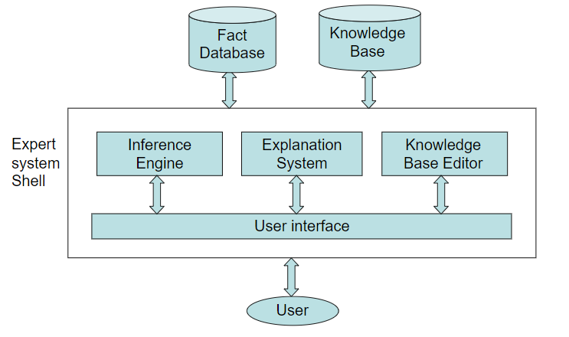
Development of an Expert System

Slide 5
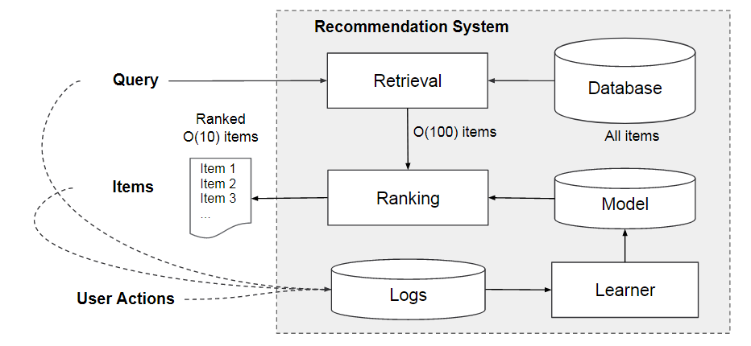
Expert system vs recommendation system

Slide 6
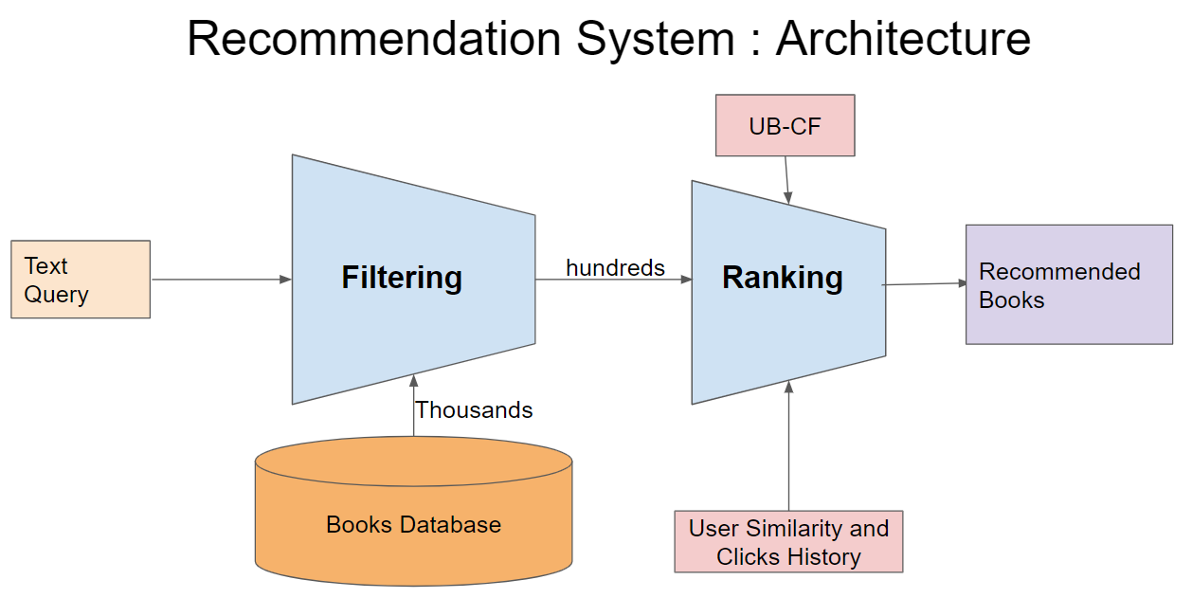
Expert system vs recommendation system

Slide 7
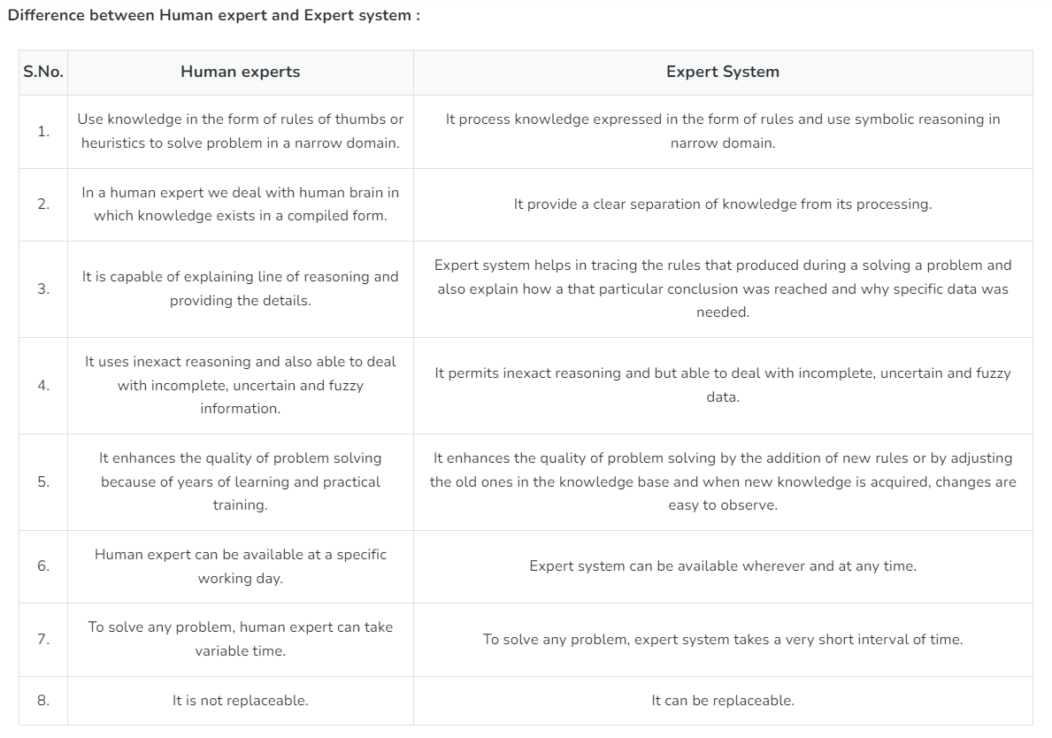

Slide 8
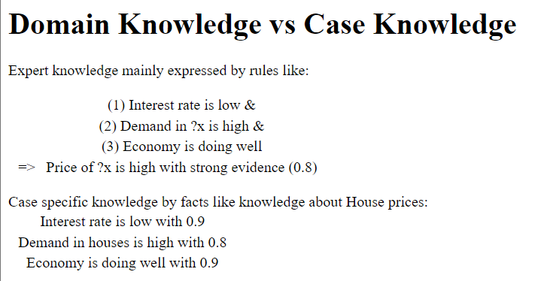
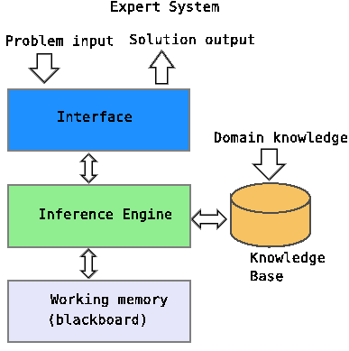

Slide 9
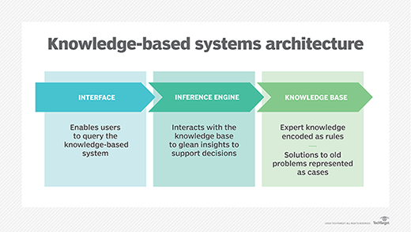
Components of Expert Systems
Domain expert
Knowledge Base
Knowledge acquisition
Inference engine
Predicting results and Explanation Mode

Slide 10
Why expert system?
Expert system provides high quality experience, domain specific knowledge; apply heuristics, forward or backward reasoning, uncertainty and explanation capability.
Rule based expert system contains knowledge base, Inference engine, knowledge acquisition, explanation facility and user interface.
For knowledge representation techniques, forward and backward chaining rules other methods are used.
Expert systems are designed to emulate an expert in a specialized knowledge domain such as medicine or any other area of knowledge where there is a shortage of expert knowledge [2].

Slide 11
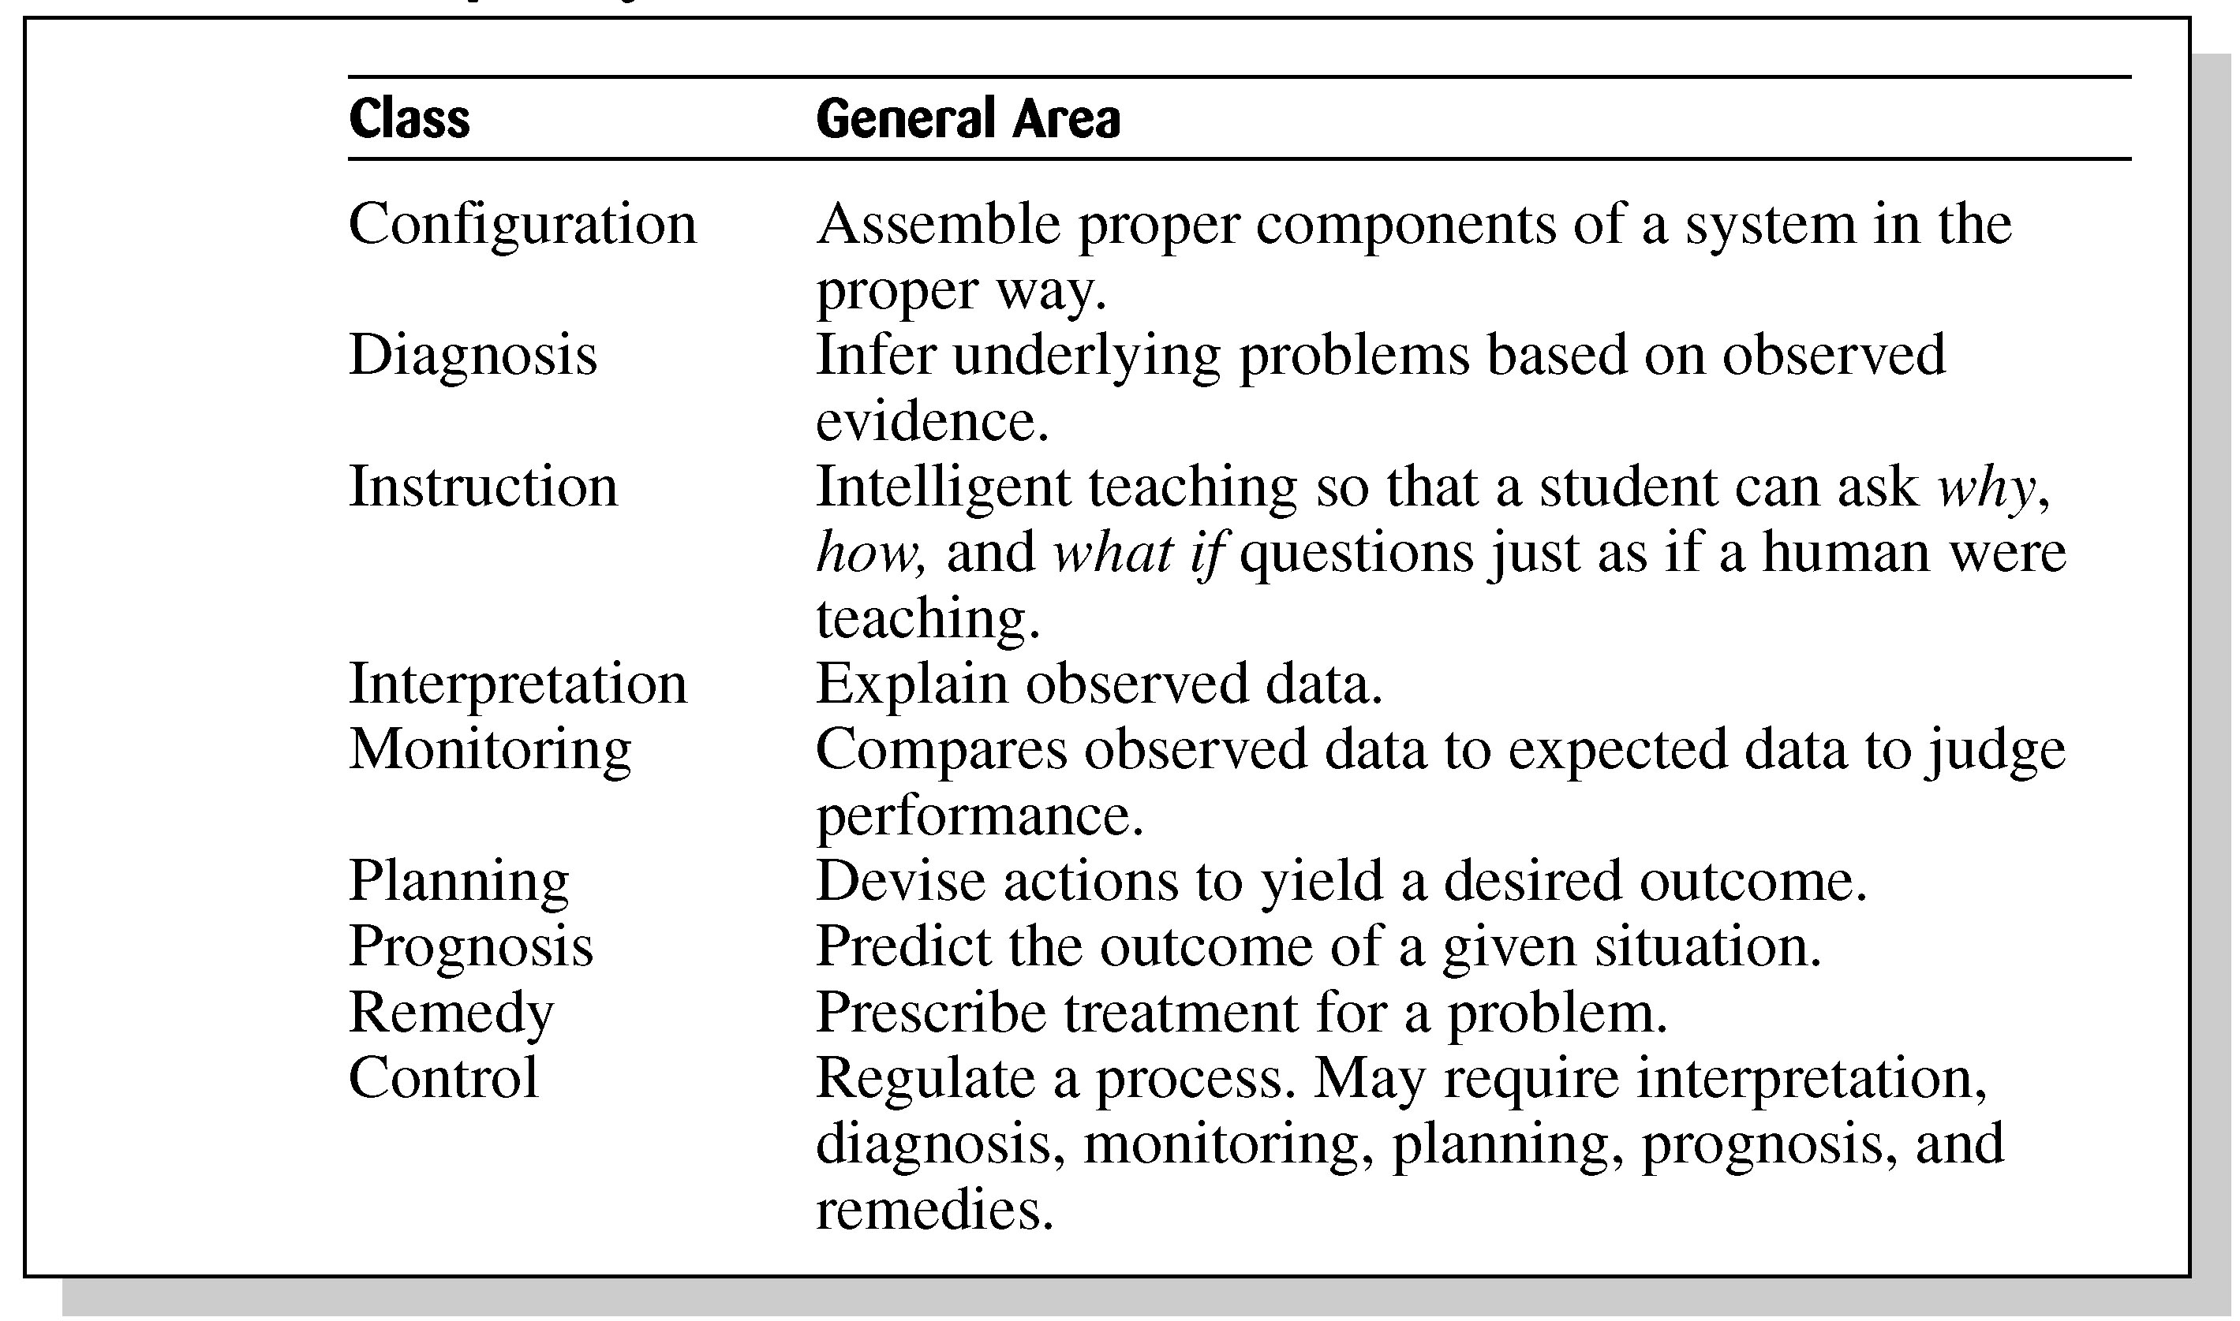
Table 1.3 Broad Classes of Expert Systems

Slide 12
Expert systems Vs conventional programs I

Slide 13
Expert systems Vs conventional programs III

Slide 14
“While consulting the information provided by the expert system, the explanation module elucidates why the expert system reached its conclusion.”

Slide 15
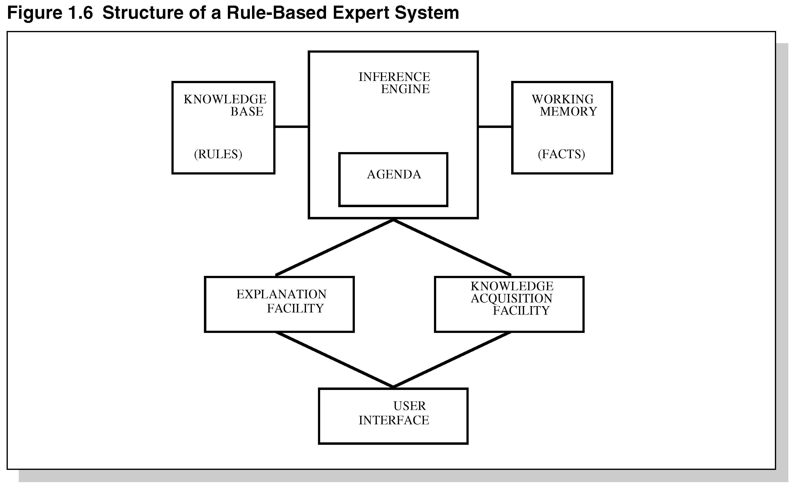
Figure 1.6 Structure of a Rule-Based Expert System

Slide 16
The expert knowledge area is "fuzzy" in nature and contains a great deal of procedural knowledge
Knowledge-based systems represent a way that expertise can be captured, coded, and reused.
Expert system contains a knowledge base having accumulated experience and a set of rules for applying the knowledge base to each particular situation that is described to the program.

Slide 17
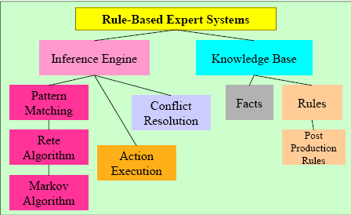
Foundation of Expert Systems

Slide 18
Rule-Based ES

Slide 19
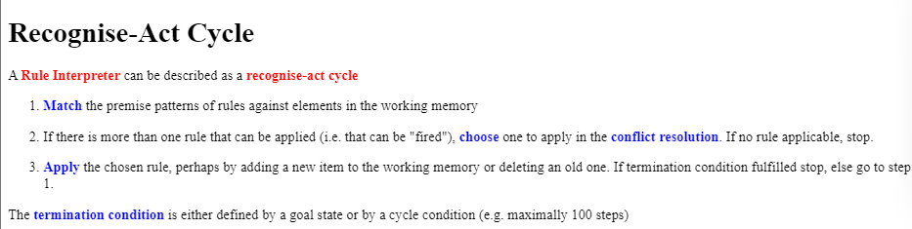

Slide 20
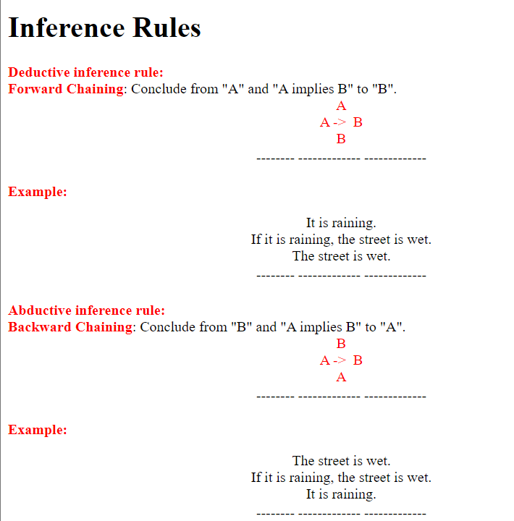

Slide 21
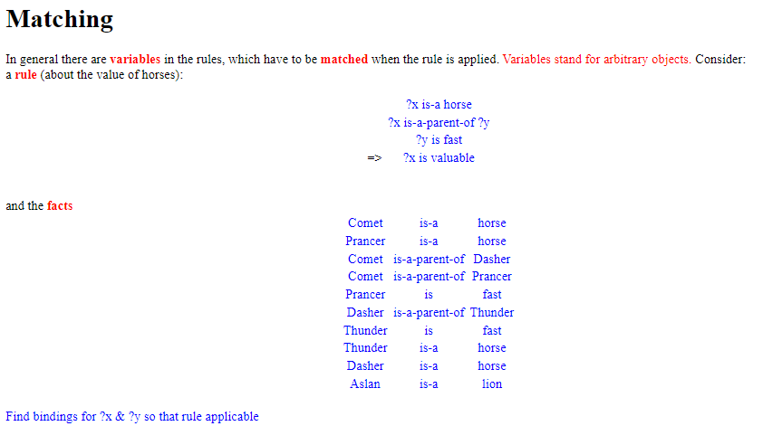

Slide 22
The bindings for ?x is-a horse: ?x -> Comet, ?x -> Prancer, ?x -> Thunder, and ?x -> Dasher The bindings for ?y is fast ?y -> Prancer and ?y -> Thunder
The bindings for ?x and ?y in ?x is-a-parent-of ?y are: ?x -> Comet,?y -> Dasher; ?x -> Comet,?y -> Prancer; and ?x -> Dasher,?y -> Thunder I.e., "Comet is-a horse" matches "?x is-a horse" but "Aslan is-a lion" does not match "?x is-a horse“
Rule applicable with bindings ?x -> Comet,?y -> Prancer and ?x -> Dasher,?y -> Thunder
That is new facts that can be derived are: valuable(Comet) and valuable(Dasher)
Matching (Cont'd)

Slide 23
Backward Chaining and forward Chaining
A backward chaining system can be driven by a block of data supplied at the start – and there are often good reasons to do so. Likewise, a data driven system may appear to interact with the user in a manner similar to a backward chaining system.
During backward chaining, if any rule assigns a value to variable X, that rule is automatically available whenever other rules being tested need a value of X. Rules can be physically located anywhere in the system, and there is no explicit linking of rules. Having two rules use the same variable is all that the inference engine needs to link them.

Slide 24
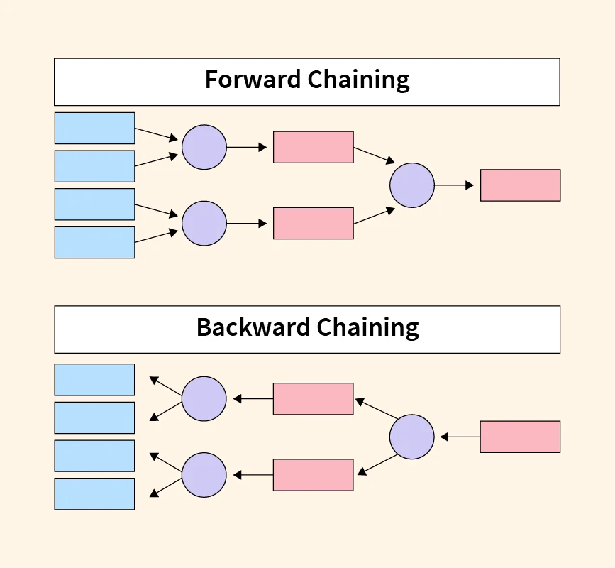

Slide 25
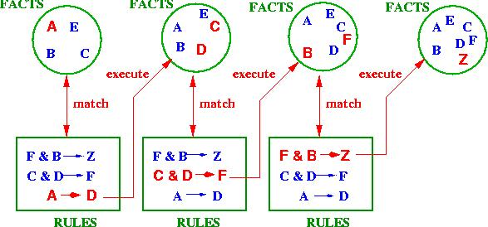
Forward Chaining
Forward chaining or data-driven inference works from an initial state, and by looking at the premises of the rules (IF-part), perform the actions (THEN-part), possibly updating the knowledge base or working memory. This continues until no more rules can be applied or some cycle limit is met, e.g.

Slide 26
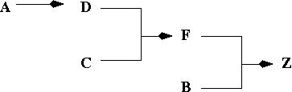
Forward Chaining – in search of data
In example: no more rules, that is, inference chain for this is:
Problem with forward chaining: many rules may be applicable. The whole process is not directed towards a goal.

Slide 27
Backward Chaining- one target driven approach
Backward chaining or goal-driven inference works towards a final state, and by looking at the working memory to see if goal already there. If not look at the actions (THEN-parts) of rules that will establish goal, and set up subgoals for achieving premises of the rules (IF-part).
This continues until some rule can be applied, apply to achieve goal state.
Advantage of backward chaining: search is directed
Disadvantage of backward chaining: goal has to be known
Now look at the example from above with backward chaining

Slide 28
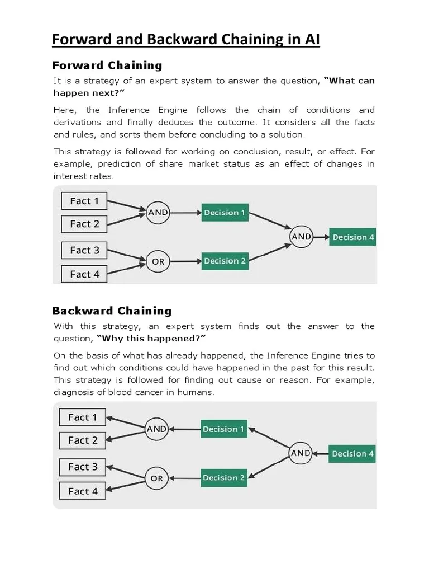
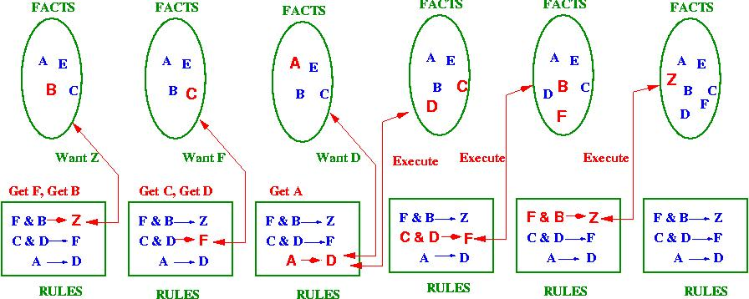

Slide 29
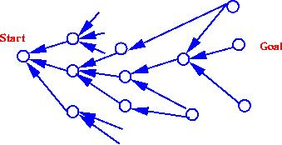
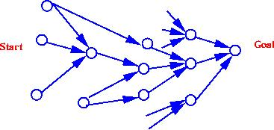
Forward or Backward Reasoning?
If it is a query to which a response is required, backward chaining is more natural.
In which direction is branching factor greatest? Go in direction with lower branching factor, backward chaining better:
What kind of events triggers problem-solving? If it is arrival of a new fact, forward chaining makes sense.
Forward chaining better:
Has program to justify reasoning? Prefer direction that corresponds more closely to the way users think.

Slide 30
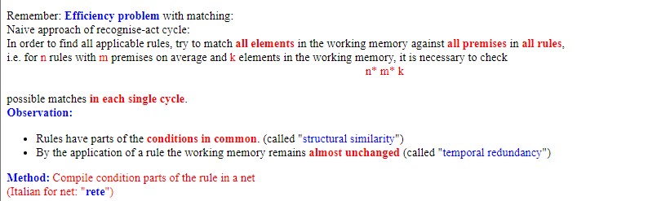
The Rete-Algorithm

Slide 31
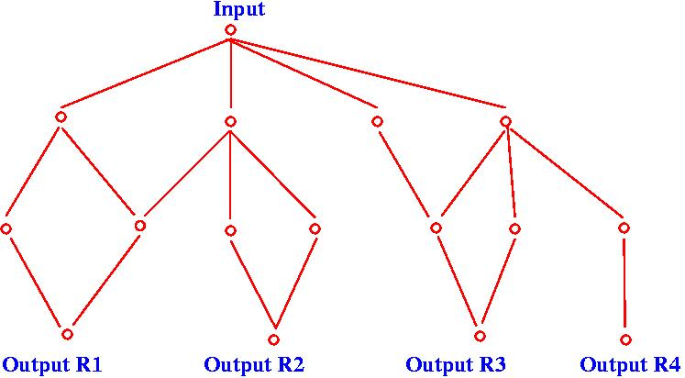
The Rete-Algorithm Example
The net encodes the condition parts (IF-parts) of the rules.
The input are the changes of the working memory (i.e. new elements or deleted elements.
Modification of elements is simulated by first delete then add modified version)
The output is the applicable rules

Slide 32
Rules:
IF a customer has made more than 5 purchases, THEN they are a “Loyal Customer.”
IF a customer has spent more than $500 in total, THEN they are a “High-Spending Customer.”
IF a customer is both “Loyal” and “High-Spending,” THEN they get a 10% discount on their next purchase.
Facts:
Customer A has made 7 purchases and spent $600.
Customer B has made 3 purchases and spent $400.
Customer C has made 6 purchases and spent $700.
Applying the Rete Algorithm:
The algorithm efficiently evaluates the rules against the facts:
Customer A: Loyal (yes), High-Spending (yes) → 10% discount
Customer B: Loyal (no), High-Spending (no) → No discount
Customer C: Loyal (yes), High-Spending (yes) → 10% discount
Result:
Customer A and Customer C receive a 10% discount on their next purchase because they meet both criteria.

Slide 33
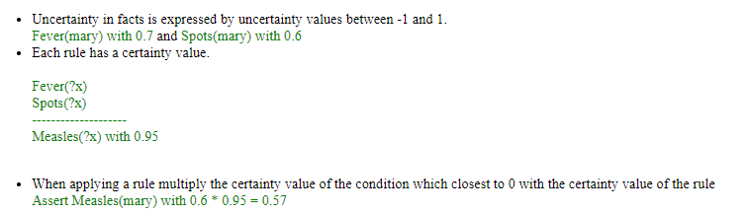
Uncertainty in Rules and Facts

Slide 34
Example of uncertainty
Facts:
It is warm
John has a height of 180cm
The power is switched off
The door is open
Rules:
IF the temperature is more than 21ºC THEN switch the central heating off.
IF a person is tall THEN he can get the book from the shelf.
IF the power is switched off THEN the machine does not work.
IF the door is open THEN close it.

Slide 35
Probability
(In finite domains) the probability can be measured as the limit of the ratio of the positive events to all possible events, e.g. with a fair die and positive outcome 5 or 6, in the long run, there is a positive outcome in 1 out of 3 cases, i.e. Probability P(5 or 6)=1/ 3.
Probability may involve random variables, e.g. the probability that it will be at least 23ºC on New Year's Eve in Birmingham can be expressed as P(t>= 23ºC,Birmingham, New_Years_Eve)=0.001
Each random variable has a domain of possible values that it can take on.

Slide 36
Conditional Probabilities
P(a|b) is the conditional probability that a is true given that it is known that b is true.
E.g. P( Measles| Spots)=0.94 is the probability that a patient has measles given that the only symptom is spots.
If other symptoms like fever, then P( Measles| Spots & Fever)
Conditional probabilities can be defined in terms of unconditional probabilities:
P(a|b)=P(a & b)/P(b)
a and b are called independent if P(a|b)=P(a). In this case P(a & b)=P(a)P(b).

Slide 37
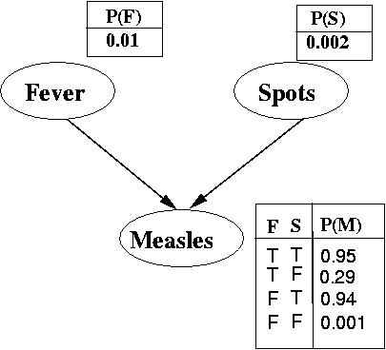
Bayesian Belief Networks
A Bayesian Belief Network is a directed acyclic graph that represents causality relationships between domain variables which consist of A set of random variables.
A set of directed arcs linking pairs of nodes; an arc from a node X to a node Y means that X has a direct influence on Y.
Each node has a conditional probability table that quantifies the effects of the parents.

Slide 38
Bayesian Belief Network (BBN), the mathematical formula used to calculate the posterior probability of a specific node given evidence observed in other nodes is based on Bayes' theorem.
The formula for calculating the posterior probability of a node X given evidence E is:
P(X|E) = P(X) * P(E|X) / P(E)
Where:
P(X|E) is the posterior probability of node X given evidence E
P(X) is the prior probability of node X
P(E|X) is the likelihood of observing evidence E given node X
P(E) is the marginal probability of observing evidence E
In the context of a BBN, the formula is applied iteratively to calculate the posterior probabilities of all nodes in the network given the observed evidence.

Slide 39
a Bayesian Belief Network for diagnosing a patient with a respiratory illness.
In this network, we have the following nodes:
Cough (C): representing the presence or absence of a cough
Fever (F): representing the presence or absence of a fever
Shortness of Breath (S): representing the presence or absence of shortness of breath
Chest Pain (P): representing the presence or absence of chest pain
Disease (D): representing the possible diseases (e.g., pneumonia, bronchitis, asthma)
The conditional probabilities in the network could be as follows:
P(D = pneumonia | C = true, F = true) = 0.8
P(D = bronchitis | C = true, F = true) = 0.15
P(D = asthma | C = true, F = true) = 0.05
These probabilities indicate the likelihood of a patient having a specific disease given the presence of cough and fever.

Slide 40
Markov Algorithm:
Purpose: The Markov Algorithm is primarily used for rule manipulation and rule modifications.
Independence Property: It defines the specific conditional independence property:
p(xt+1​∣xt​,xt−1​,...,x1​)=p(xt+1​∣xt​)
Representation: A scalar Markov process can be trivially represented by a chain Bayesian network.
Weakness: It cannot represent induced and non-transitive dependencies effectively.
Example: If we have a rule to replace ‘A’ with ‘BC’, applying this rule to the string “AAB” results in “BCB

Slide 41
1) Graph Structure:
Markov chains have a simple linear structure (a chain), while BBNs have a more complex directed graph structure.
BBNs can represent more intricate dependencies, including cycles (feedback loops).
2) Causality:
BBNs explicitly model causal relationships, whereas Markov chains focus on state transitions.
3) Conditional Independence:
BBNs capture conditional independence relationships among variables using the graph structure.
Markov chains assume only the Markov property (dependence on the current state).
4) Applications:
Markov chains are commonly used for modeling sequences and transitions.
BBNs are used for reasoning under uncertainty, decision-making, and probabilistic inference.
The kay differences

Slide 42
Using Markov Algorithm
An ordered group of productions applied in order or priority to an input string.
If the highest priority rule is not applicable, we apply the next, and so on.
inefficient algorithm for systems with many rules.
Termination on (1) last production not applicable to a string, or (2) production ending with period applied
Can be applied to substrings, beginning at left

Slide 43
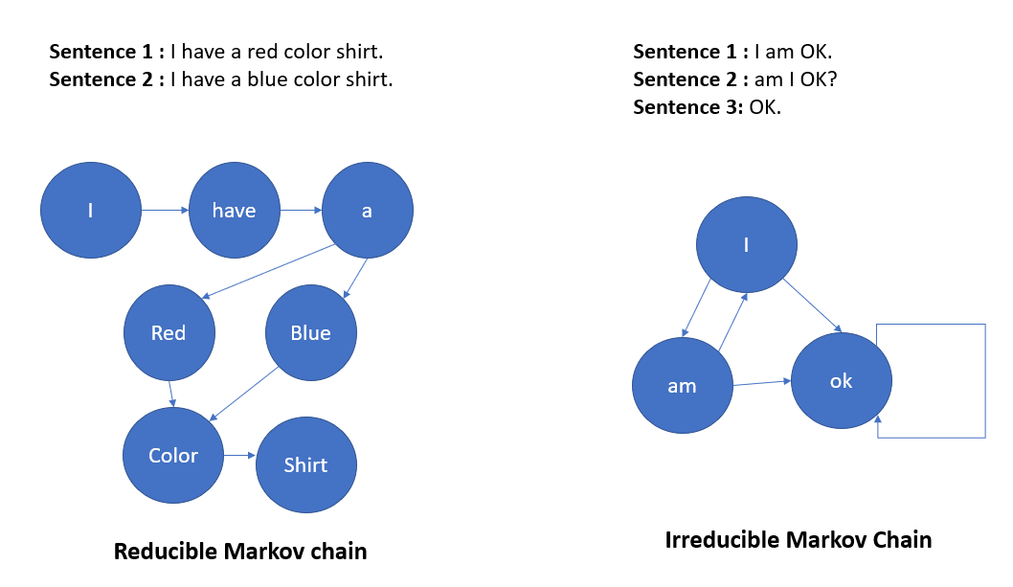

Slide 44
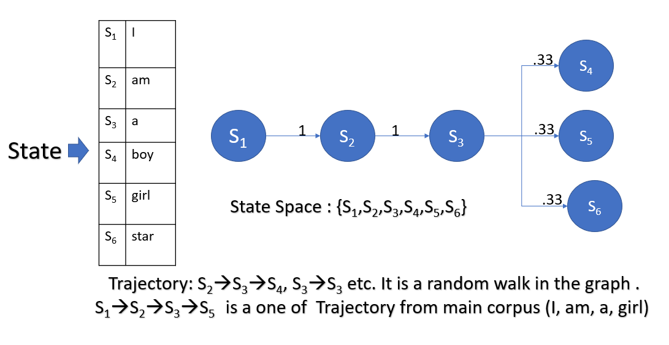

Slide 45
Example 1
An Expert system example
The IRIS Intelligent RP System Selector
The IRIS Intelligent RP System Selector is an interactive program designed to help potential purchaser in industry to select an RP system from a wide range of choices of commercially available RP systems and using a number of different selection criteria to suit the specific requirements

Slide 46
The IRIS Intelligent RP System Selector
Expert systems
Part Orientation
Process parameter optimization
Process Planning

Slide 47
The IRIS Intelligent RP System Selector
rule based knowledge representation with IF-THEN rules were used. The program handles the user input, checks the rules, does the searching for data and then gives an answer.
The program has to interpret over 500 rules before giving an answer.
Confidence factors were not used because the system is based on comparing factual exact values rather than comparing the possibilities.
The program was tested for all possible scenarios. The program gives instant error message if the user makes a mistake in entering the required data or answering the question.

Slide 48
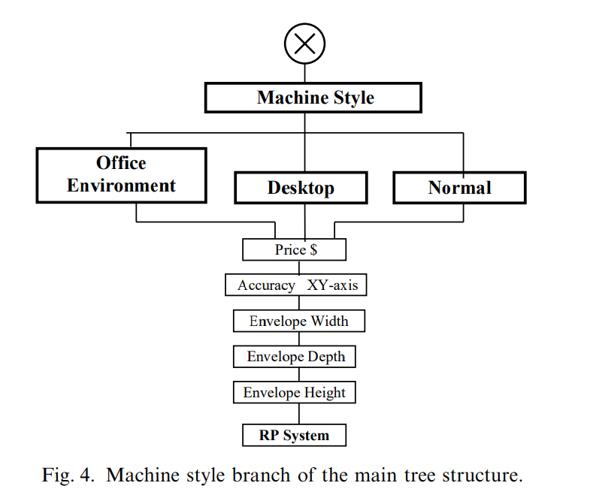

Slide 49
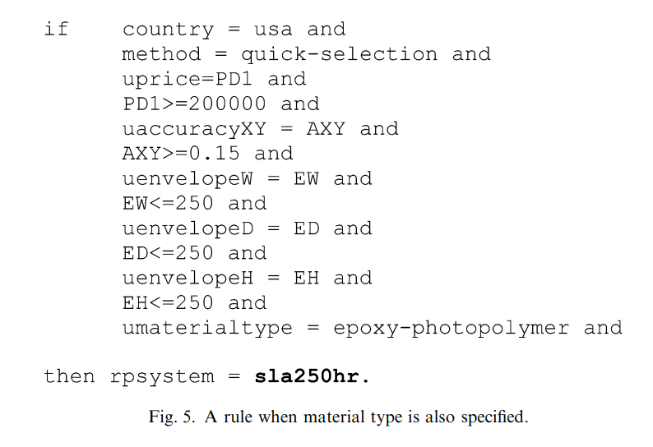

Slide 50
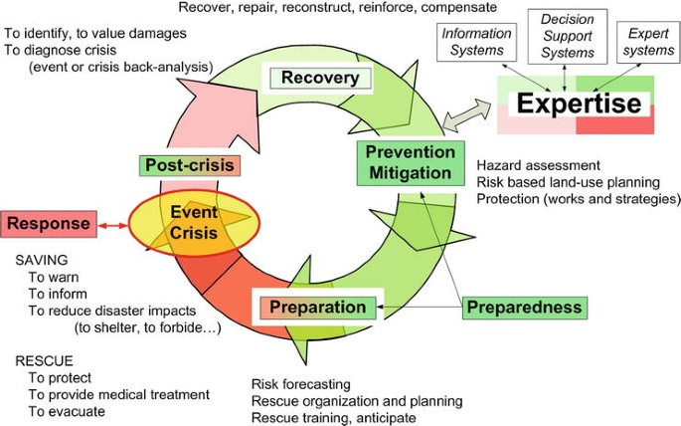
Example 2 –
Expert (Knowledge-Based) Systems for Disaster Management
An Expert (Knowledge-Based) System for Disaster Management is the DisasterAWARE platform

Slide 51
Rule Example of This System
Scenario: The system has detected a seismic event with a magnitude of 7.5 on the Richter scale in a region known for its high population density and poor building infrastructure.
Based on the rules and data available, the system would infer the following:
Rule 1: Seismic event magnitude > 6.0 -> Generate alert for potential earthquake impact.
Rule 4: High seismic activity, heavy rainfall, and unstable terrain -> Recommend evacuation to prevent landslides or mudslides.

Slide 52
Chematica's Knowledge-Based Expert System
Chematica's Knowledge-Based Expert System uses AI algorithms and expert knowledge in chemistry to analyze the chemical structures, properties, and reactions of compounds.
The chemist inputs the chemical structures of the starting materials and desired product into the Chematica platform.
The system utilizes its knowledge base and AI algorithms to predict the most efficient reaction pathways and conditions for synthesizing the desired product.
Chematica provides recommendations on the optimal reaction conditions, potential side reactions to consider, and the predicted properties of the final product.
The chemist can use this information to make informed decisions on the synthesis process, select the best reaction pathway, and optimize the experimental conditions.

Slide 53
Chematica's Knowledge-Based Expert System
Rule 1: If the chemical structure contains a benzene ring and a carboxylic acid group, then predict that the compound is likely to exhibit acidic properties.
Rule 2: If the chemical structure contains a nitrogen atom with a lone pair of electrons and a hydrogen atom attached, then predict that the compound is likely to exhibit basic properties.
Rule 3: If the chemical structure contains a double bond and a halogen atom, then predict that the compound is likely to undergo electrophilic addition reactions.
Scenario: A chemist inputs the chemical structure of a compound into the system, which contains a benzene ring and a carboxylic acid group.
Inferencing: Based on Rule 1, the system would infer that the compound is likely to exhibit acidic properties due to the presence of the benzene ring and carboxylic acid group.
Decision: The chemist can use this prediction to guide further experiments or research on the compound, such as studying its reactivity in acidic conditions or exploring its potential applications in acidic environments.

Slide 54
References
https://www.scholarhat.com/tutorial/artificialintelligence/expert-system-in-ai
P. Dore , S. Chakkor, A. El Oualkadi, M. Baghouri, (2023), Real-time intelligent system for wind turbine monitoring using fuzzy system. Journal of Advances in Electrical Engineering, Electronics and Energy
S.H. Masood, A. Soo, (2002), A rule based expert system for rapid prototyping system selection, Journal of Computer Integrated Manufacturing
Backward Chaining: Expert System Fundamentals by Dustin Huntington
K P Tripathi, (2011), A Review on Knowledge-based Expert System: Concept and Architecture, IJCA Special Issue on “Artificial Intelligence Techniques - Novel Approaches & Practical Applications”
Shu-Hsien Liao, (2004), Expert system methodologies and applications—a decade review from 1995 to 2004, Journal of Expert Systems with Applications
https://www.teachict.com/as_a2_ict_new/ocr/A2_G063/334_applications_ict/expert_systems/miniweb/pg4.html
Bogdan Walek, , Petr Fajmon, (2023), A hybrid recommender system for an online store using a fuzzy expert system, journal of expert systems with applications 212 (2023) – 118565
Atul Mishra and Sankha Deb, (2016) An intelligent methodology for assembly tools selection and assembly sequence optimization, DOI: 10.1007/978-81-322-2740-3_31

Slide 55
THANK YOU For Your attention

